Slide 1
High-Availability Cluster Management
Architecting resilience and high performance for scientific computing
PROJECT SHOWCASE
GROUP NO - 2

Slide 2



System Architecture Overview
Computational Power
Resilience
Security
Scaling intensive scientific workloads across multiple worker nodes using Slurm
for maximum throughput.
Eliminating Single Points of Failure through Active/Passive master redundancy and automated failover protocols.
Fortress approach utilizing centralized LDAP authentication, WireGuard VPN tunnels, and strict network hardening.

Slide 3
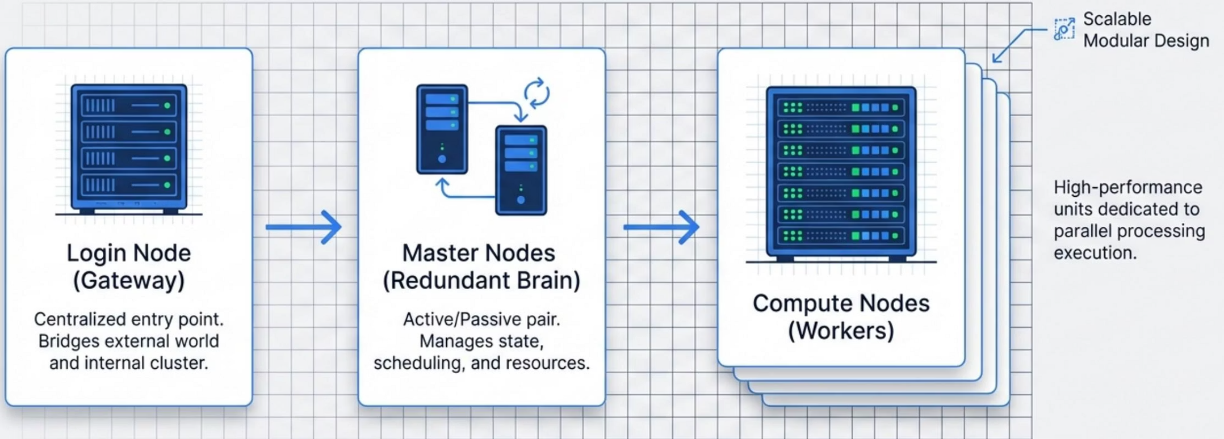
Cluster Node Hierarchy
01
Login Node (Gateway)
Centralized entry point bridging external world and internal cluster.
02
Master Nodes (Redundant Brain)
Active/Passive pair managing cluster state, scheduling, and resources.
03
Compute Nodes (Workers)
High-performance units dedicated to parallel processing execution with scalable modular design.

Slide 4
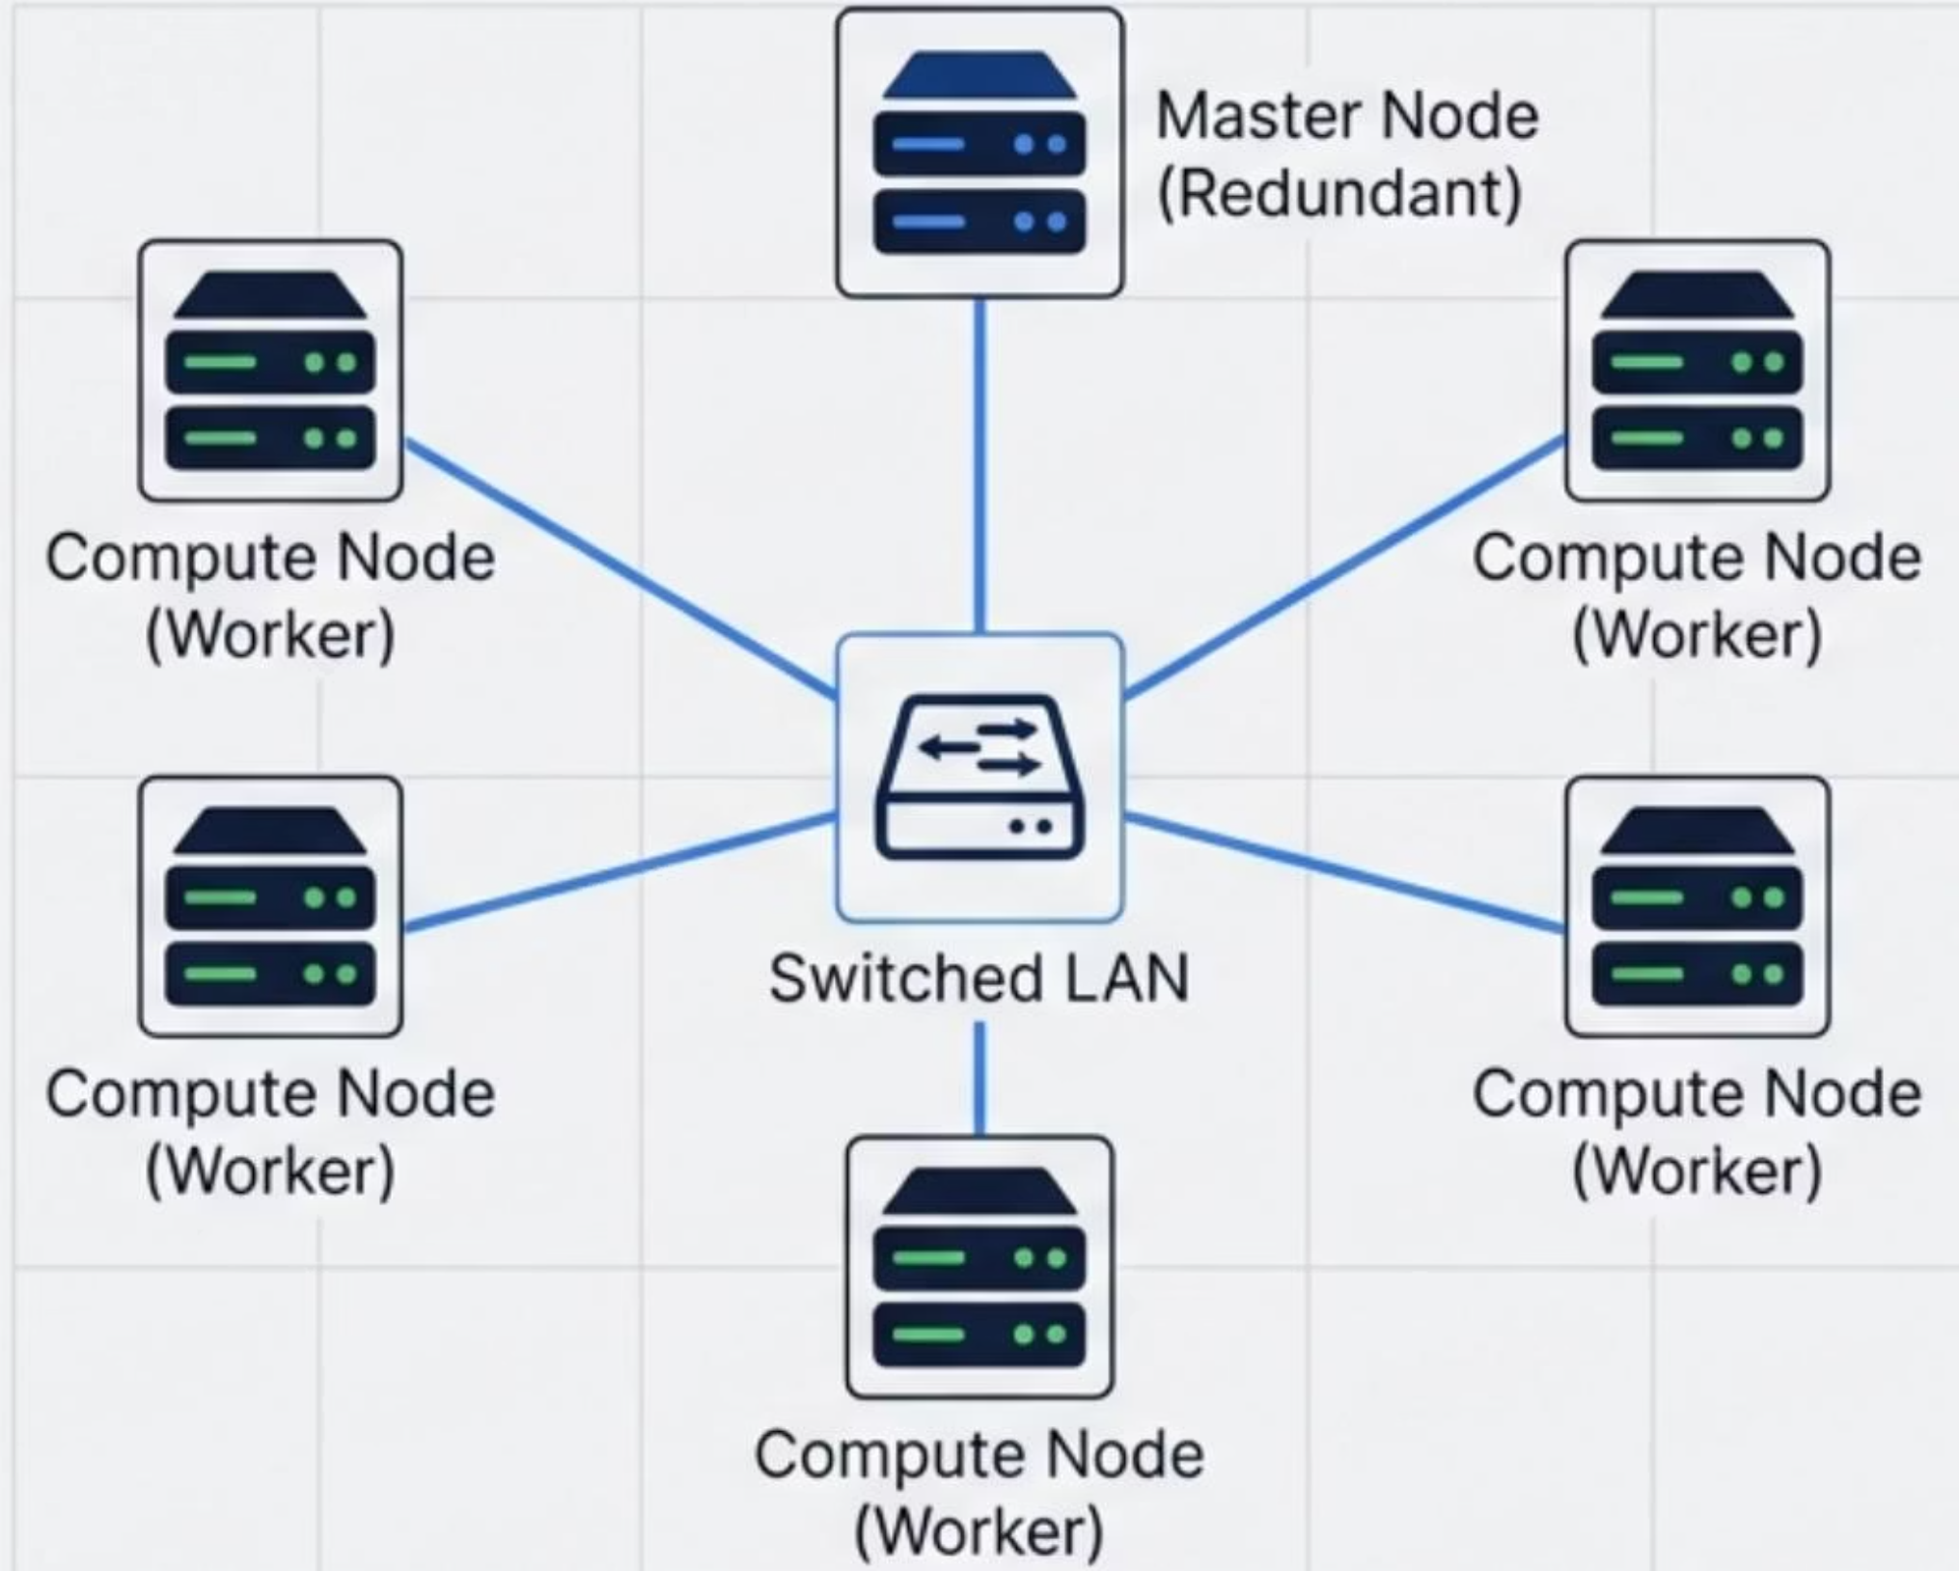
Optimized Network Topology
Key Engineering Decisions
Switched LAN
Centralized high-speed switching ensures ultra-low latency communication.
Star Topology
Prevents data collision and ensures high throughput.
Isolation Strategy
Internal traffic strictly segmented from college network for security.

Slide 5



IP Planning & Core Connectivity
Private IP Range
MAC Binding
Dual-Homing
Dedicated internal subnet for inter-node communication, ensuring total isolation from external traffic.
DHCP static leases via MAC binding guarantee nodes receive the same IP after reboot—essential for Slurm.
Login node bridges the gap, possessing interfaces for both internal cluster network and external backbone.
Critical Services: DNS | NTP | DHCP

Slide 6

Multi-Layered Security Protocols
Secure SSH Access
Only Ed25519 key-based SSH authentication is allowed
Network Hardening
UFW firewall with iptables rules enforcing strict network access control.
WireGuard VPN
Secure remote administrative access tunnel.

Slide 7
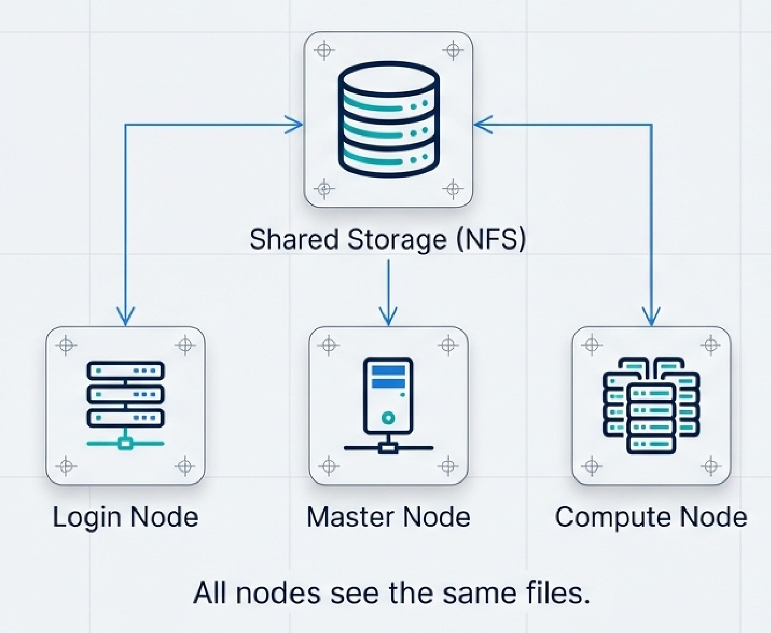
Shared Storage Architecture
Users experience uninterrupted access with no data or job loss as shared storage is built using LVM volumes replicated and exported through NFS.

Slide 8
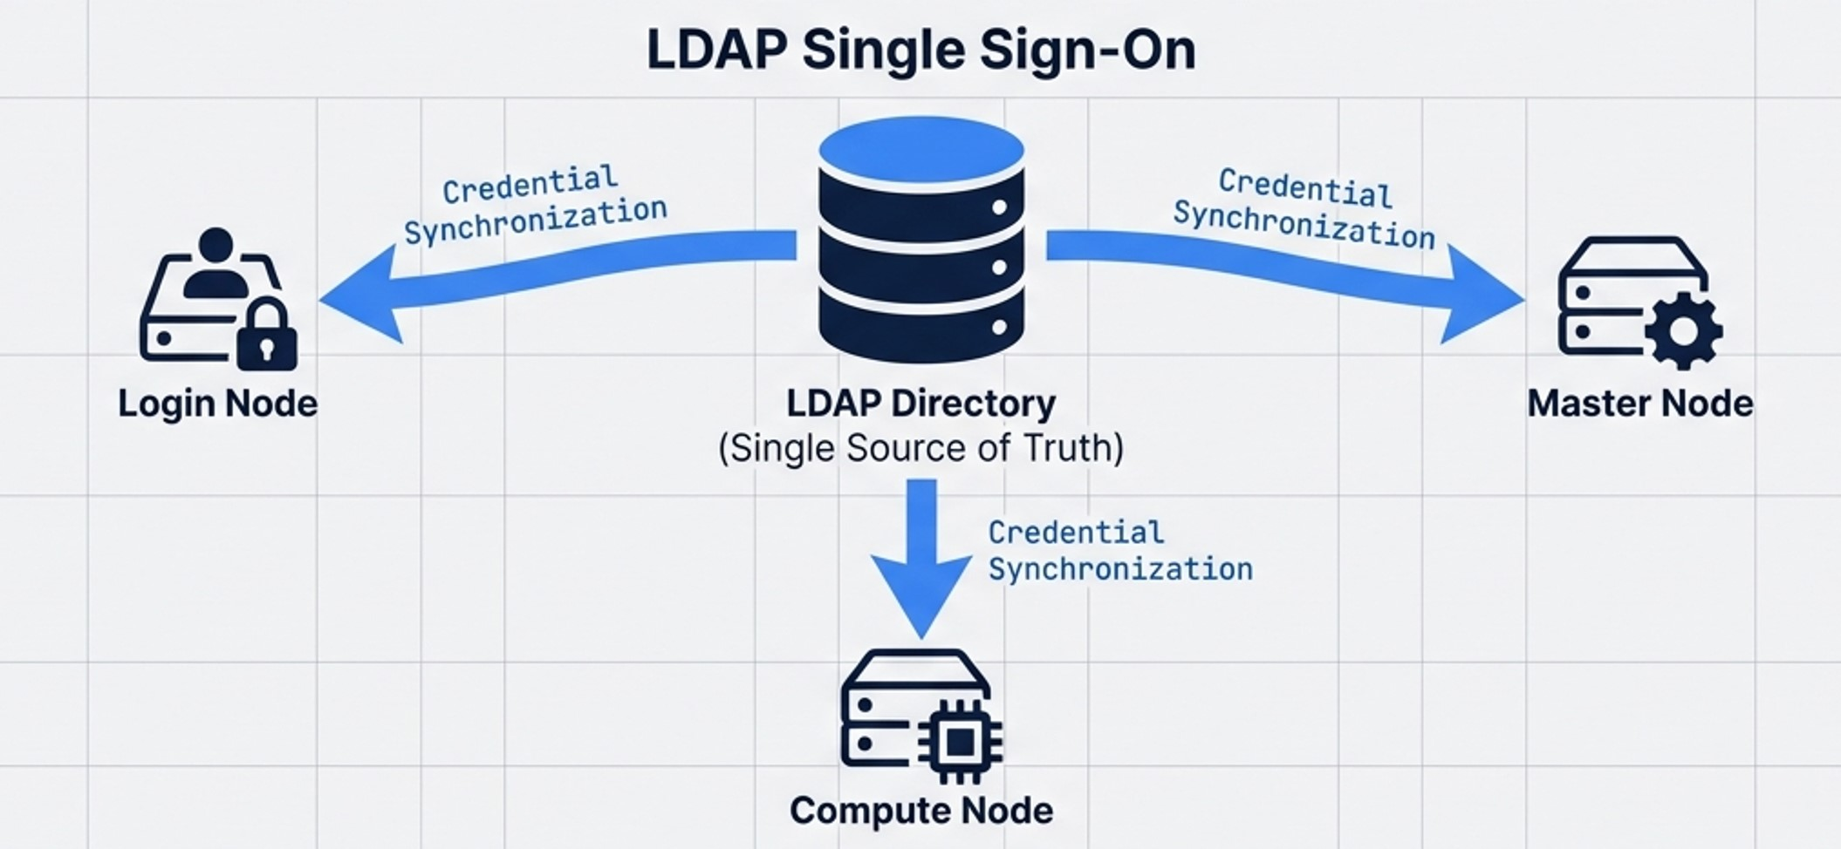
Security & Centralized Identity
LDAP Single Sign-On
Single Sign-On (SSO)
Unified User Directory
NFS Integration
Users log in once; credentials sync cluster-wide
Central management of groups and permissions
Home directories map automatically upon login

Slide 9
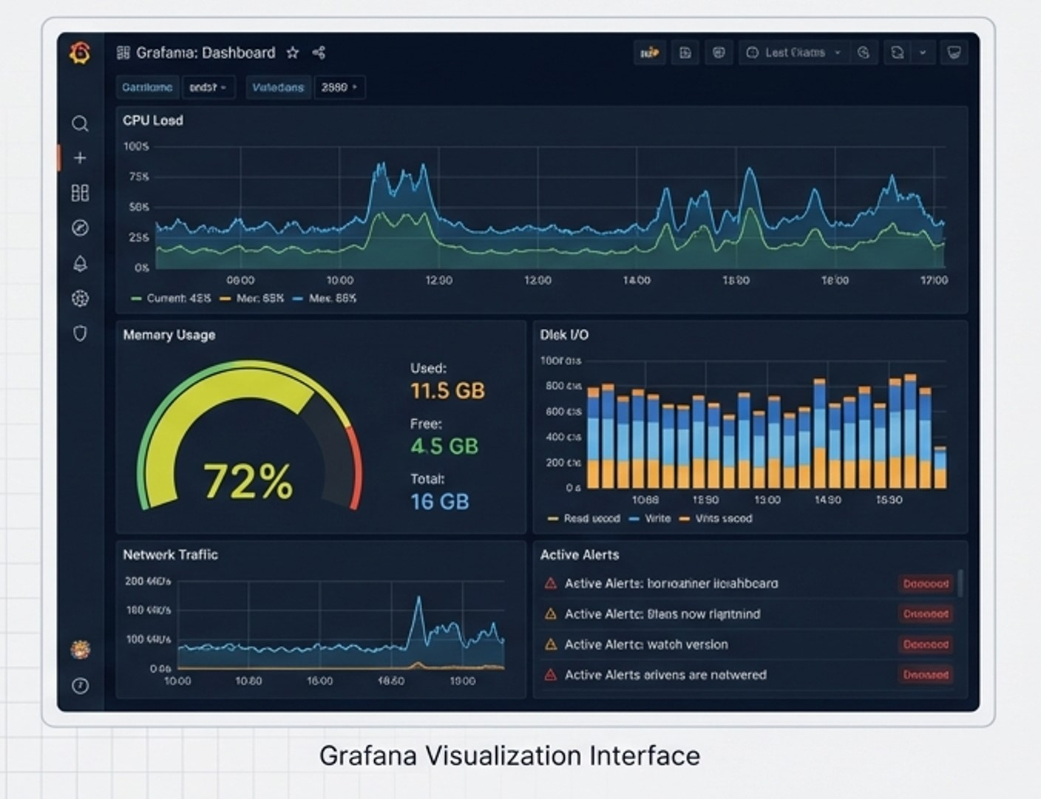
System Observability & Monitoring
Observability Stack
Node Exporter
A lightweight agent that extracts raw hardware and OS metrics from the server and exposes them for collection.
Prometheus
A monitoring system that scrapes and stores time-series telemetry data from various exporters.
Grafana
A visualization platform that queries collected data to create real-time, interactive dashboards.

Slide 10
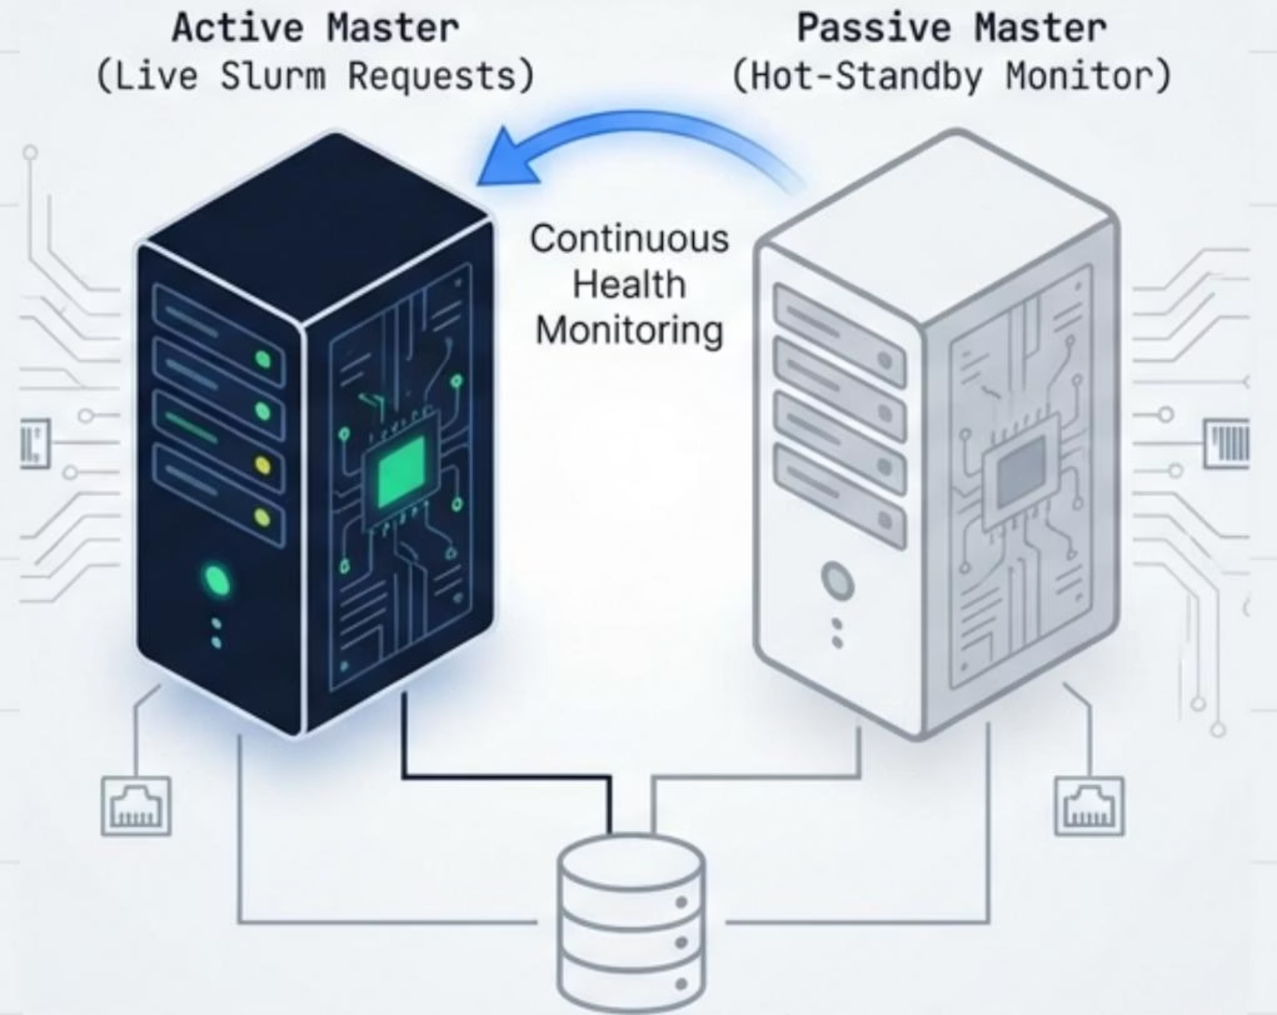
The Availability Challenge
Active/Passive Architecture
01
Active Master
Handles Slurm requests and resource management
02
Passive Master
Continuously monitors the health of the Active node.
03
Failover
In event of failure, Passive master assumes the Virtual IP instantly

Slide 11
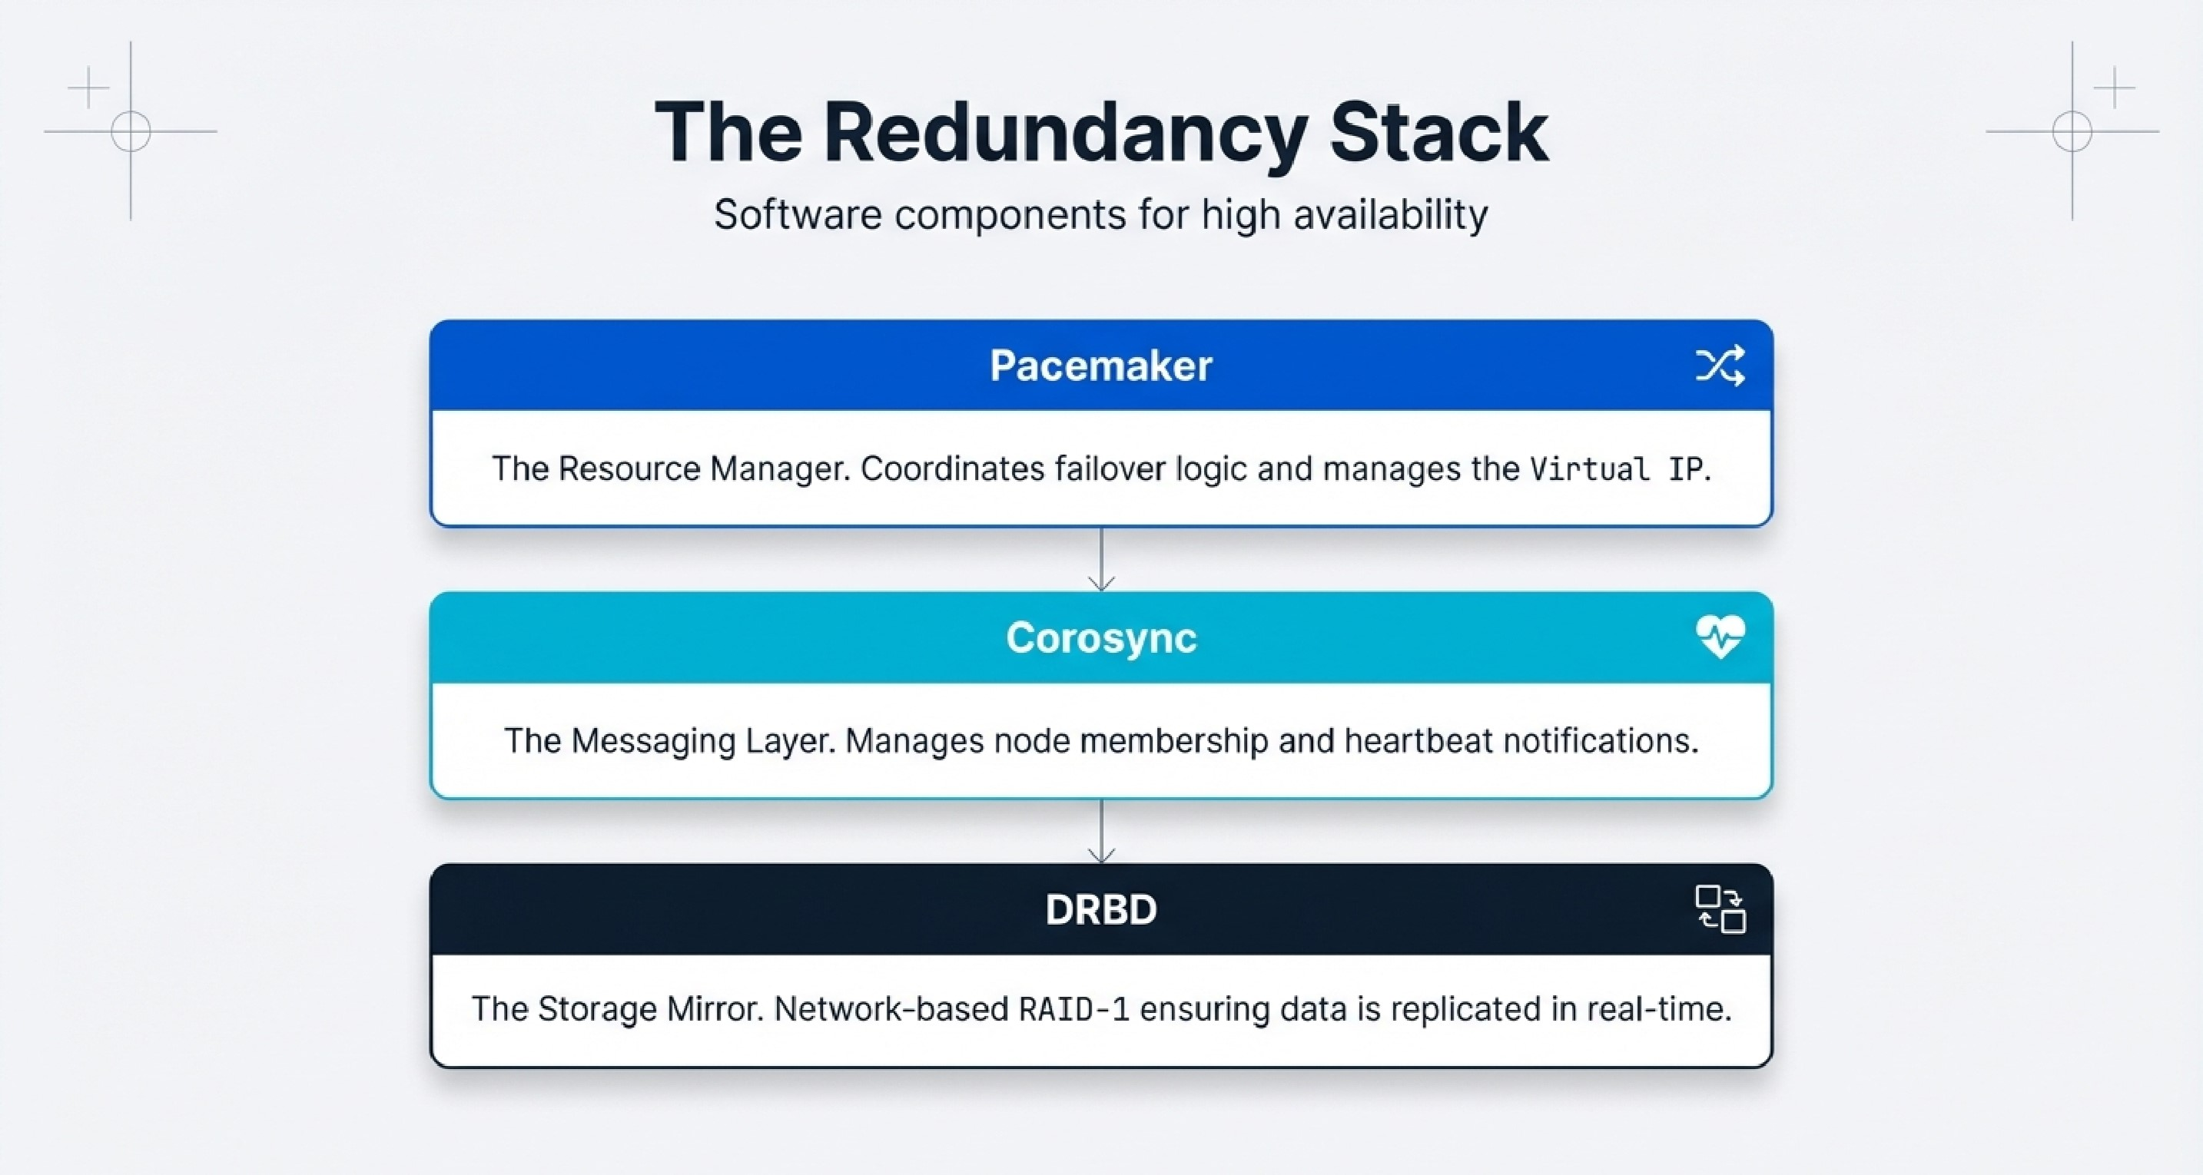

Slide 12
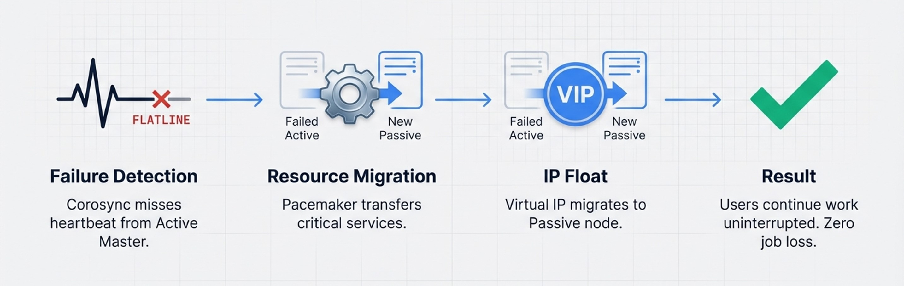
Automated Failover Logic
Users continue work uninterrupted with zero job loss. Corosync detects heartbeat failure, Pacemaker transfers critical services, and Virtual IP migrates to Passive node seamlessly.

Slide 13
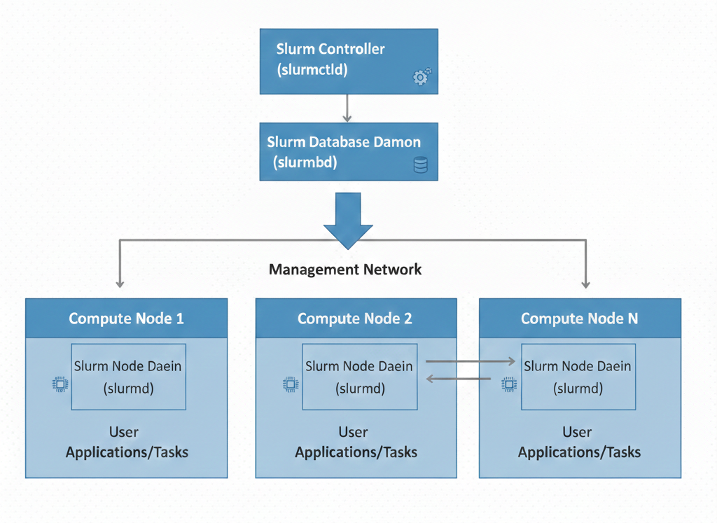

Slurm: The Cluster Architecture
Central slurmctld controller runs on Active Master, managing the central scheduler and database for historical accounting.
Multiple slurmd agents run on Compute Nodes, executing commands and reporting status.
Functionality: Prioritizes queue management and dynamically assigns CPUs/Memory to prevent contention.

Slide 14
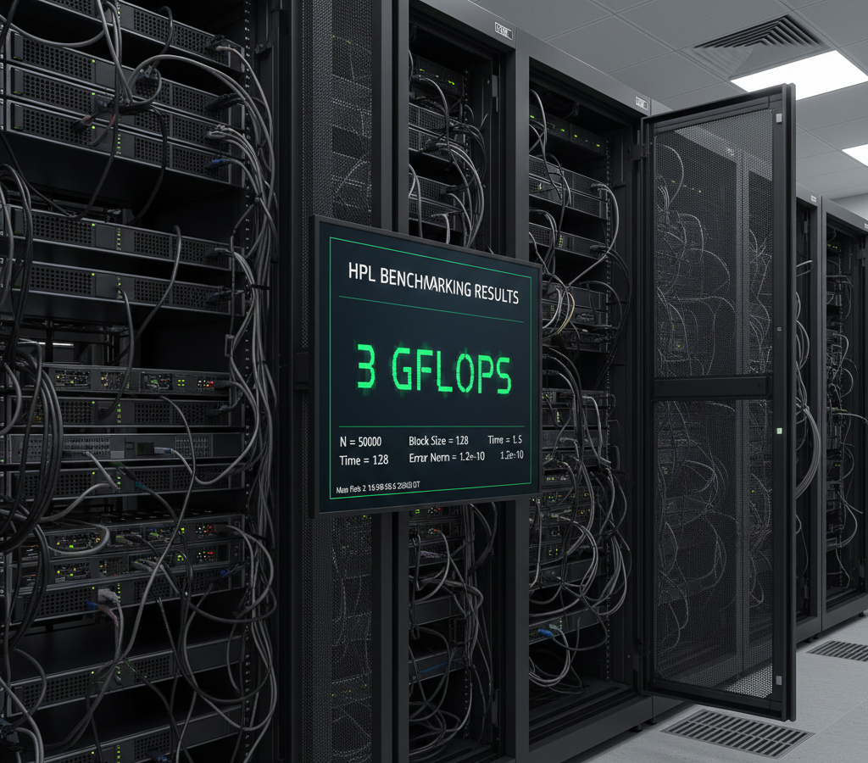
System Benchmarking (HPL)
High-Performance Linpack Results
Objective:
Validated theoretical vs. Real-world performance of the compute.
GFLOPS Measurement:
Calculated floating-point operations per second to verify peak power.
Stability Test:
Hardware stressed under 100% load to verify thermal stability
Cluster Benchmarking obtained:
3.6865e+02 GFLOPS in 925.91 seconds

Slide 15
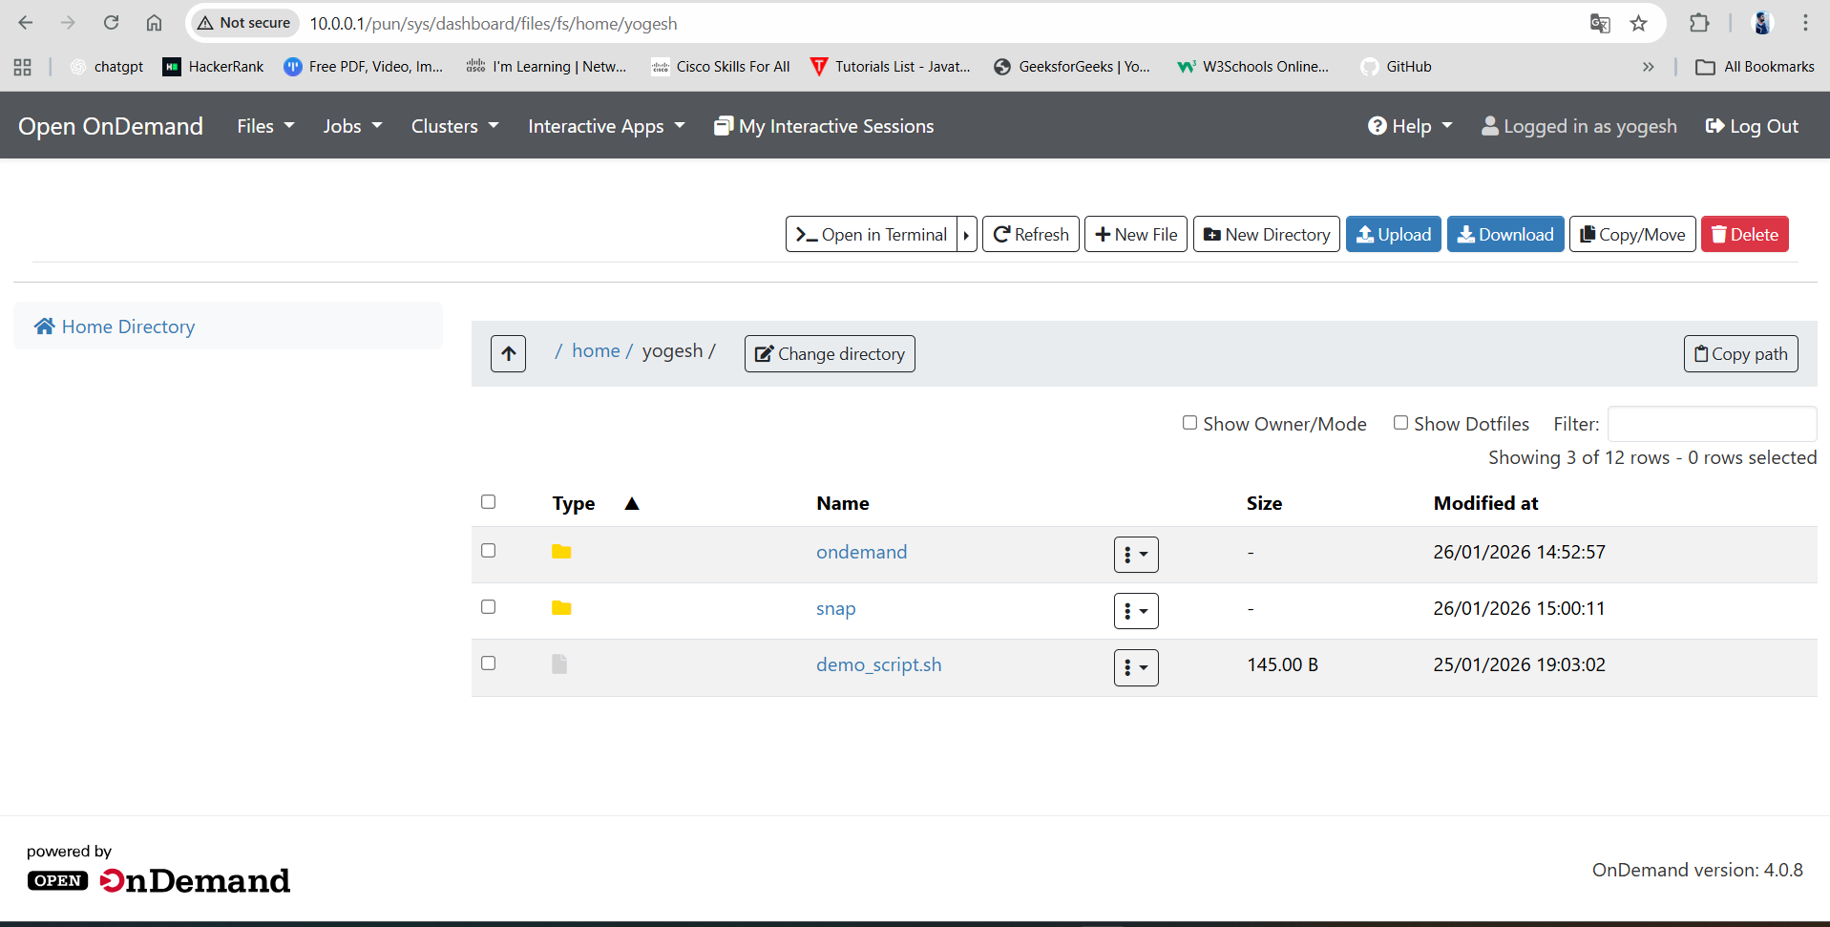
Application Layer (OnDemand Web Portal)
Browser-based interface replacing complex command-line interactions. Features drag-and-drop file management, real-time job monitoring, and interactive script submission.

Slide 16
Thank You.

